Slide 1

DAWOOD UNIVERSITY OF ENGINEERING AND TECHNOLOGY DEPARTMENT OF BASIC SCIENCES AND HUMANITIES
Subject: Applied Physics
Course code: BS-1001
Discipline: Bachelor of Cyber Security
Semester: First Semester, First year
Effectiveness: Batch-2023
Course type: Compulsory
Marks: Theory: 100 Practical: 50
Credit Hours: 3 CH 1CH
Teaching Scheme: 3HRS/week 3HRS/week
Assessment: 20% sessional, 30% Mid semester, 50% Final Exam
Books:
1. physics For scientists and engineers by Serway Jewett
2. Semi conductor Physics by Macalve
3. University physics by Freemen and Young

Slide 2
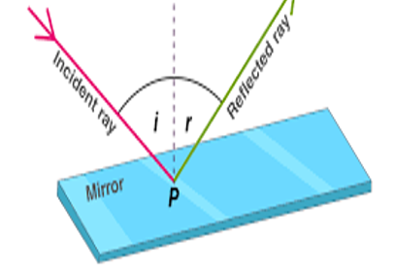

REFLECTION
When a ray of light approaches a smooth polished surface and the light ray bounces back, it is called as Reflection of Light. The incident ray that land on the surface is reflected off the surface as well and so the ray that bounces back is termed as Reflected ray.

Slide 3
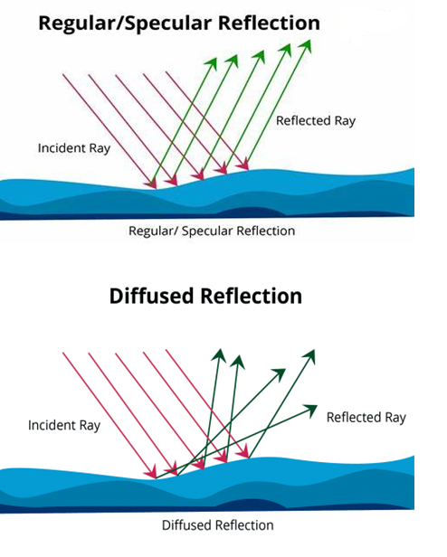
TYPES OF REFLECTION
1. Regular Reflection:
The regular reflection takes place when a light ray hits a smooth polished surface like plane mirror, a stainless steel ana a thin sheet of aluminum.
2. Irregular Reflection:
The irregular reflection takes place when light rays hits rough or unpolishes surface like wood, paper etc. Here, the light after reflection is reflected in different directions.

Slide 4
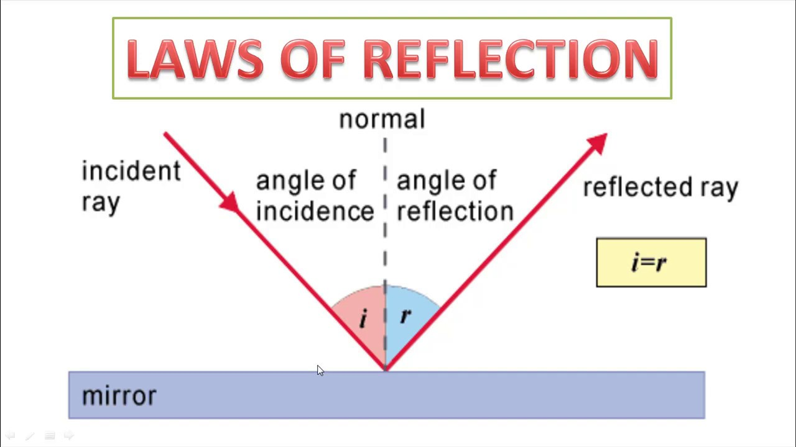
Law Of Reflection
There are two laws of reflection .
1. The Angle of the reflection ray equals the angle of the incident ray, with respect to normal.
2. The incident ray, reflected ray, and normal all the lie in the same plane. The incident and reflected ray are on opposite sides of the normal.

Slide 5
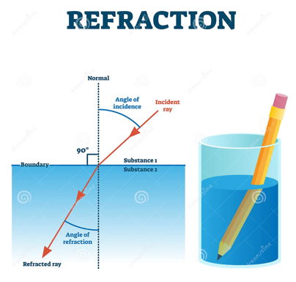
REFRACTION
“Refraction is the change in the direction of a wave passing from one Transparent medium to another medium.”
oR
Refraction is the bending of light (it also happens with sound, water and other waves) as it passes from one transparent substance into another.
This bending by refraction makes it possible for us to have lenses, magnifying glasses, prisms and rainbows. Even our eyes depend upon this bending of light.

Slide 6
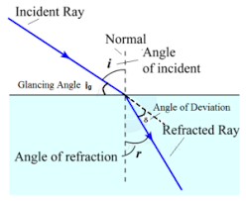
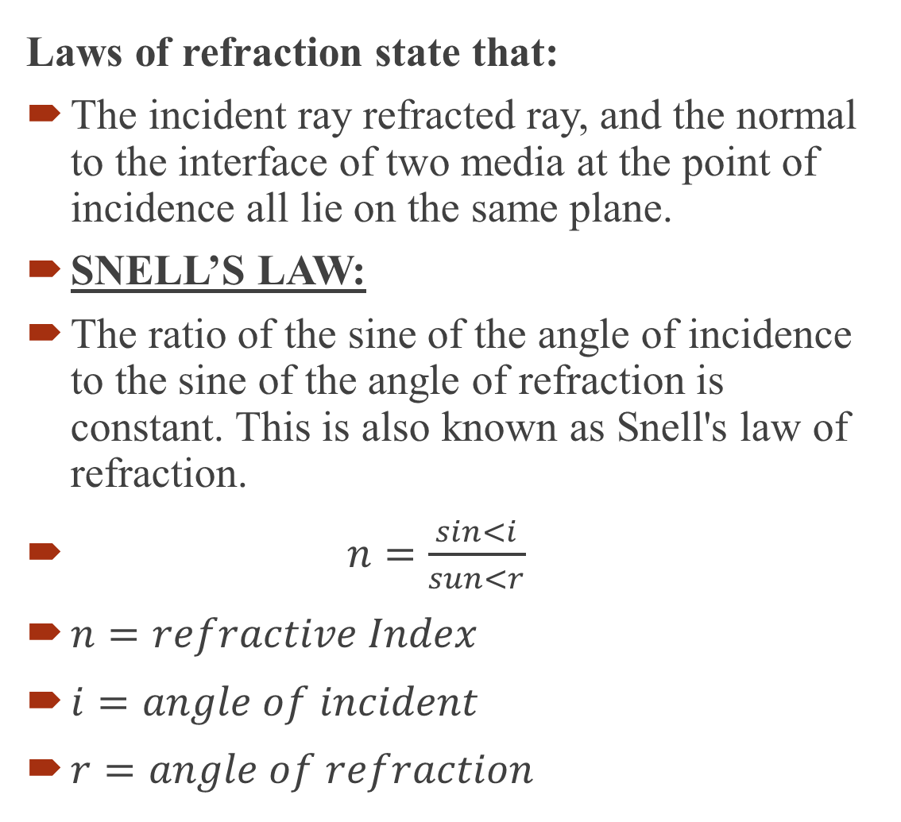
LAWS OF REFRACTION
Laws of refraction state that:
The incident ray refracted ray, and the normal to the interface of two media at the point of incidence all lie on the same plane.
SNELL’S LAW:
The ratio of the sine of the angle of incidence to the sine of the angle of refraction is constant. This is also known as Snell's law of refraction.
$n=\frac{sin<i}{sun<r}$
$n=refractive Index$
$i=angle of incident$
$r=angle of refraction$

Slide 7
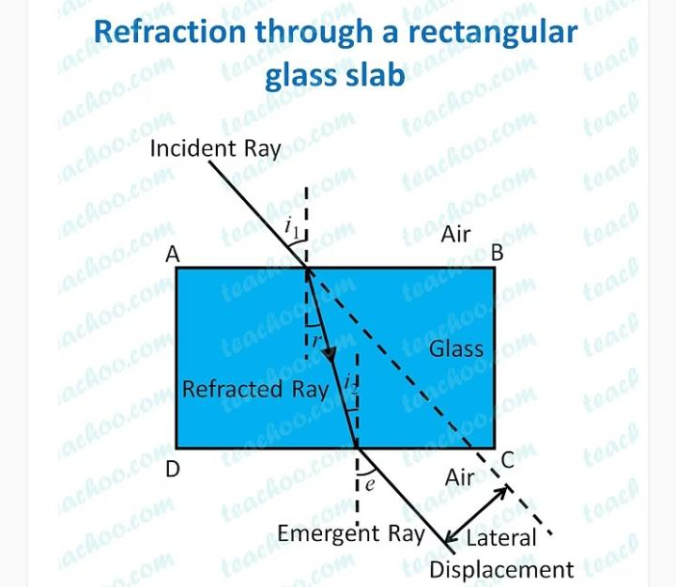
Refraction of light through glass slab:
When a ray of light passes through a rectangular glass slab, it gets
bent twice at the air- glass interface and at the glass- air interface.
The emergent ray is parallel to the incident ray and is
displaced through a distance.

